Slide 1
useReducer() Hook

Slide 2
To help you separate the concerns – rendering and state management – React provides the hook useReducer().
The hook does so by extracting the state management out of the component.
The useReducer(reducer,initialState) hook accepts 2 arguments.
The reducer function
Initial state
The hook then returns an array of 2 items: the current state and the dispatch function.

Slide 3
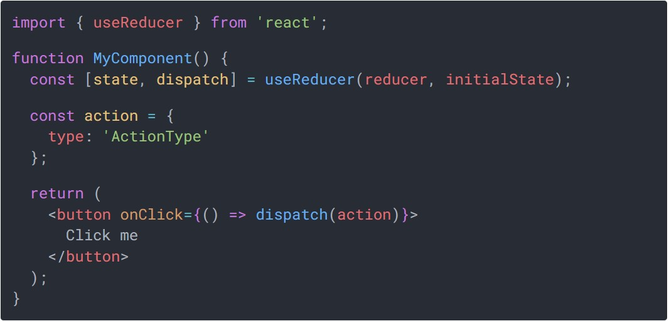

Slide 4
Initial State
The Initial State is the value the state is initialized with.
Action Object
An action object is an object that describes how to update the state
Typically, the action object would have a property type – a string describing what kind of the state update the reducer must do.
Action object can also have payload.
Dispatch Function
It is a special function that dispatches an action object
The dispatch function is created for you by the useReducer() hook

Slide 5
Whenever you want to update the state, you simply call the dispatch function with the appropriate action object.

Slide 6
Reducer Function:
The reducer is a pure function that accepts 2 parameters: the current state and an action object.
Depending on the action object, the reducer function must update the state in an immutable manner, and return the new state.

Slide 7
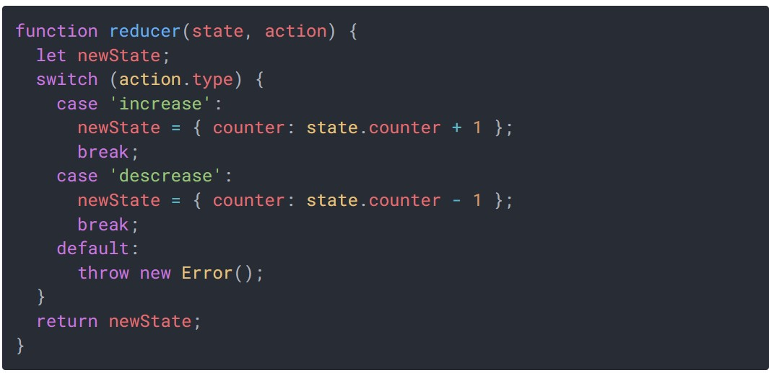

Slide 8
The reducer above doesn't modify directly the current state in the state variable, but rather creates a new state object stored in newState, then returns it.
React checks the difference between the new and the current state to determine whether the state has been updated, so do not mutate the current state directly.

Slide 9
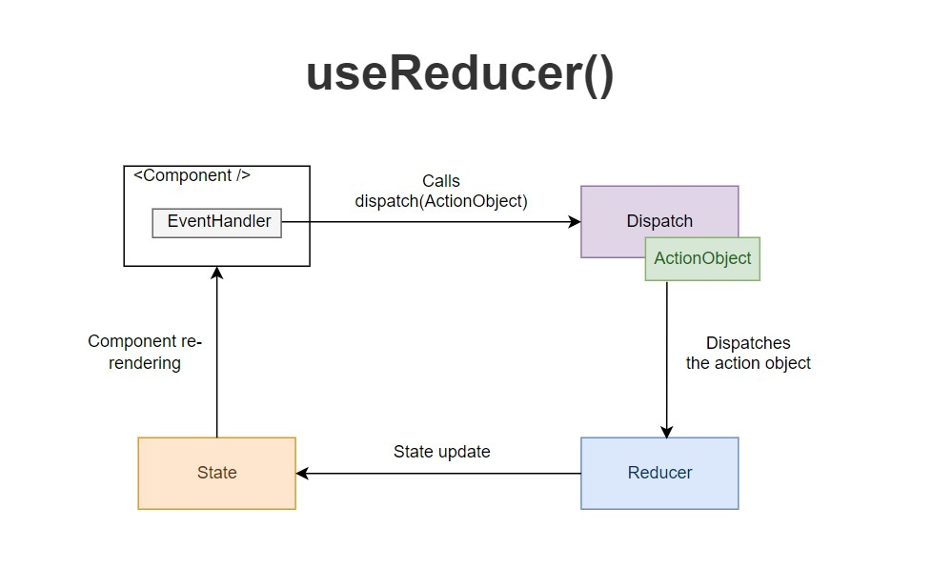
Wiring Altogether

Slide 10
As a result of an event handler or after completing a fetch request, you call the dispatch function with the action object.
Then React redirects the action object and the current state value to the reducer function.
The reducer function uses the action object and performs a state update, returning the new state.
React then checks whether the new state differs from the previous one. If the state has been updated, React re-renders the component and useReducer() returns the new state value: [newState, ...] = useReducer(...).

Slide 11
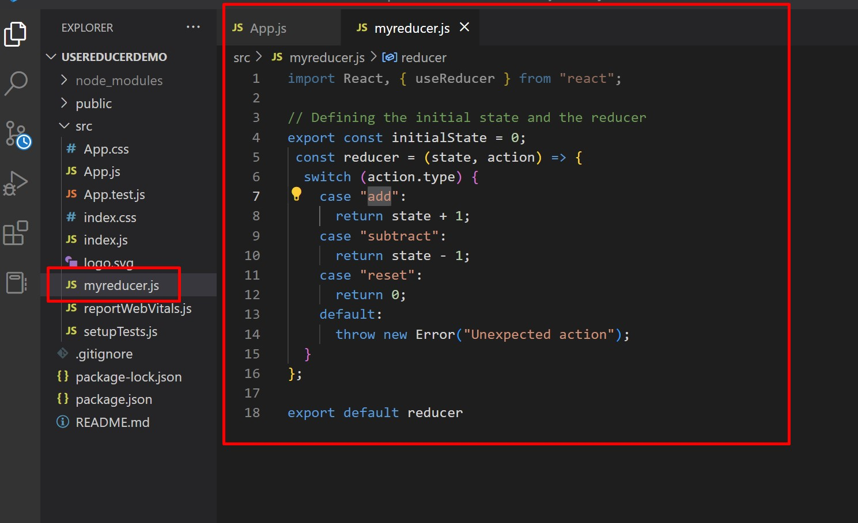
Create new project. Create new file→myreducer.js

Slide 12
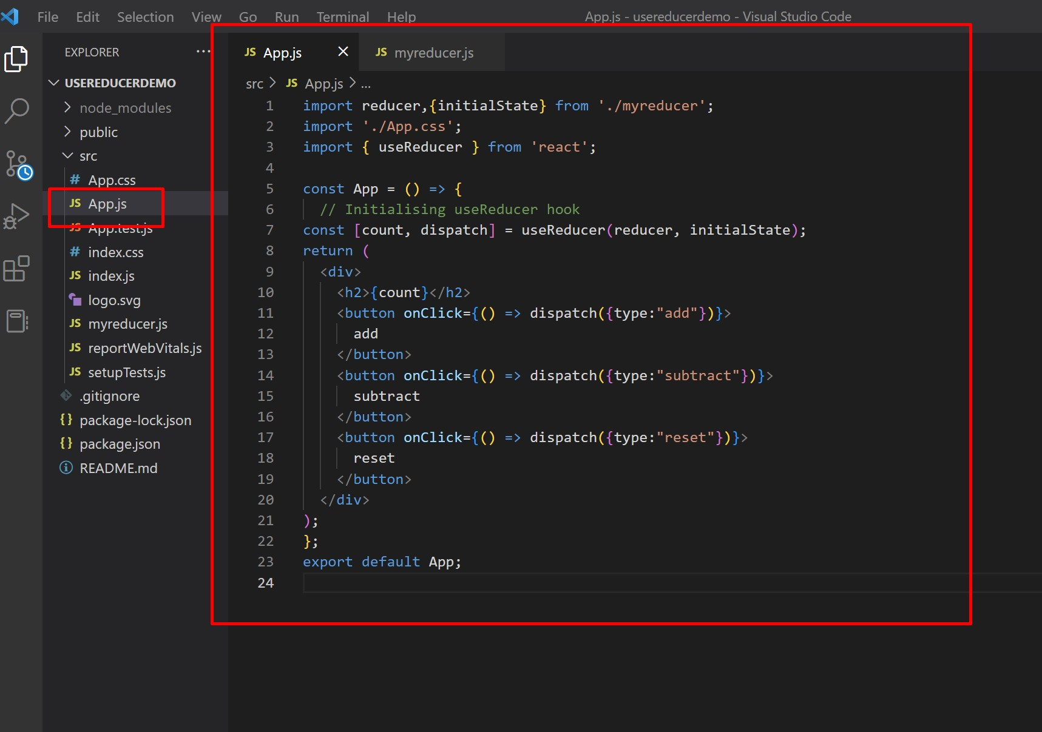
Go to App.js and modify the code. Run application and check output.

Slide 13
